Slide 1
VR Development 101
Unity XR Foundations and “Hello VR Beginner”

Slide 2
Content
Unity XR Framework, Plug-in Framework
What is XR Interaction Toolkit and what does it generally handle?
What is XR SDK and what are the general and mostly used APIs
Hello VR Beginner: The Escape Room
Import Unity Asset
Deploy to Oculus!

Slide 3
(Unity) XR Framework
Unity supports these platforms for XR:
ARKit
ARCore
Microsoft HoloLens
Windows Mixed Reality
Magic Leap
Oculus
OpenXR
PlayStation VR
Unity does not support XR on WebGL

Slide 4

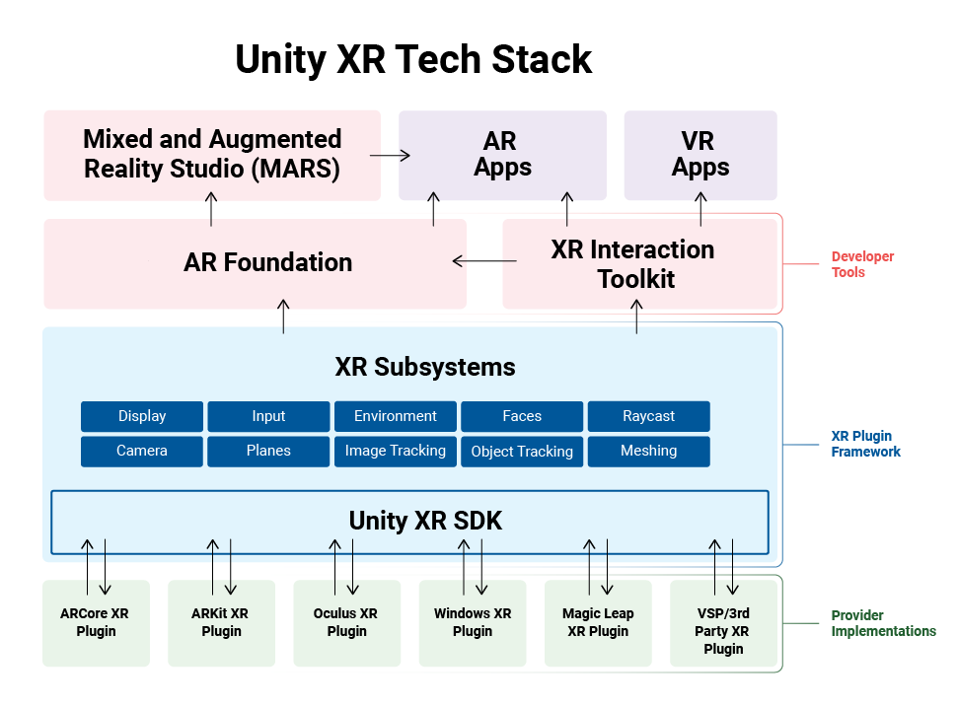
Plug-in Framework
Unity 2019.3 and newer versions use a new, unified plug-in framework that enables direct integrations for multiple platforms. The tech stack consists of an API that exposes common functionality across the platforms Unity supports and enables XR hardware and software providers to develop their own Unity plug-ins.
Similar to MRTK

Slide 5
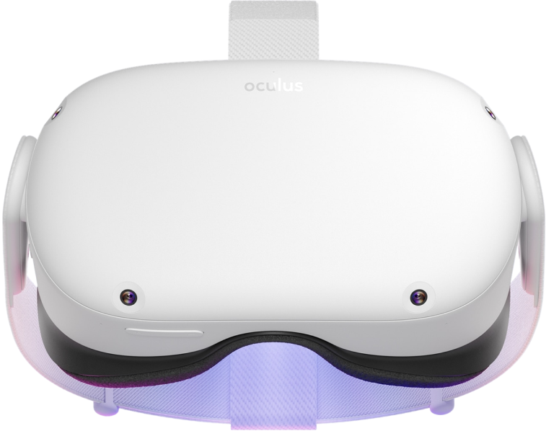
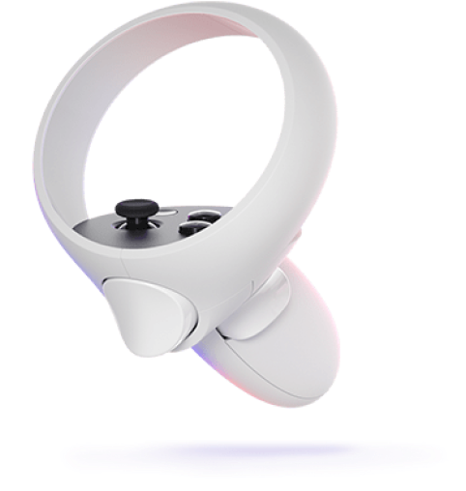
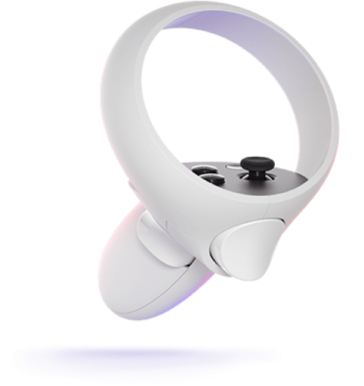
General XR SDK (Provider-end)
(Taking OpenVR as example)
System (Core)
World Position and Tracking (headset and controllers)
Display settings
Event access (device connect/disconnect)
Input (Interactions)
Define buttons (action sets)
Share bindings with any supported devices
Others (Miscellaneous)
Playground soft and hard bounds
Render setting for 2D/3D contents (Meshing optimization)
camera access, video streaming access

Slide 6
General XR Interaction Toolkit (Developer-end)
(Taking XR Interaction Toolkit as example) high-level, component-based, interaction systems
They support the following Interaction tasks
Basic object hover, select and grab
Haptic feedback through XR controllers
Visual feedback (tint/line rendering) to indicate possible and active interactions
Basic canvas UI interaction with XR controllers
A VR camera rig for handling stationary and room-scale VR experiences
Raycast
Button Press
Position and Tracking
Physical Collider
Visual Feedbacks
Haptic Feedbacks

Slide 7
Hello VR Beginner
Device:
Oculus Focus 2 (Supported by Unity XR SDK)
Vive Focus 3 (Need to import a new XR SDK)
Scene Setting
Import VR Beginner: https://learn.unity.com/project/vr-beginner-the-escape-room?uv=2019.4
Event Trigger/Button Press Trigger
Why physical Collider Trigger is not recommended?
Project setting
XR plug-in, Player setting, Platform Setting
Oculus Quest 2 Development Setting with Unity
Oculus developer account, phone app, turn on the developer mode
Build and play

Slide 8
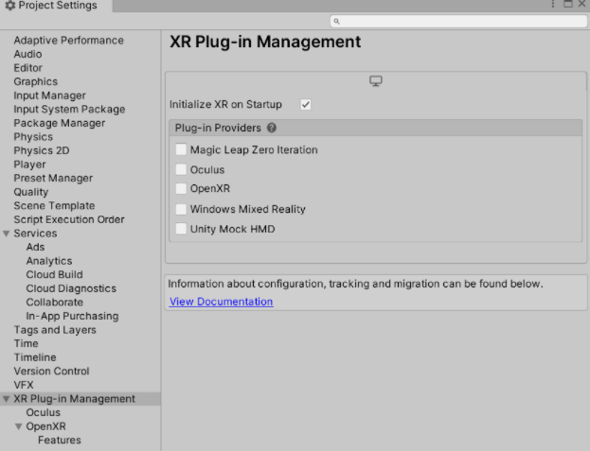
Configure Unity Project

Slide 9
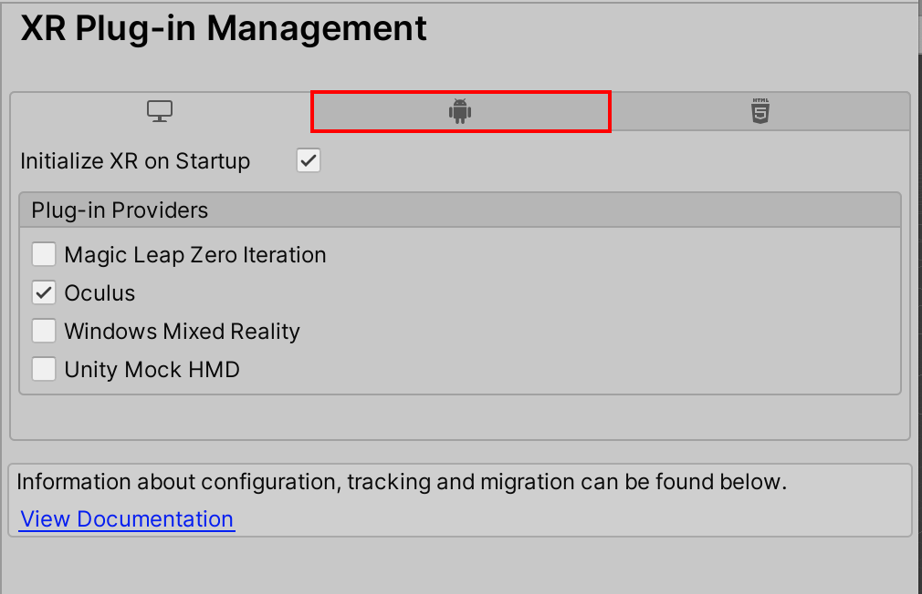
Configure Unity Project

Slide 10
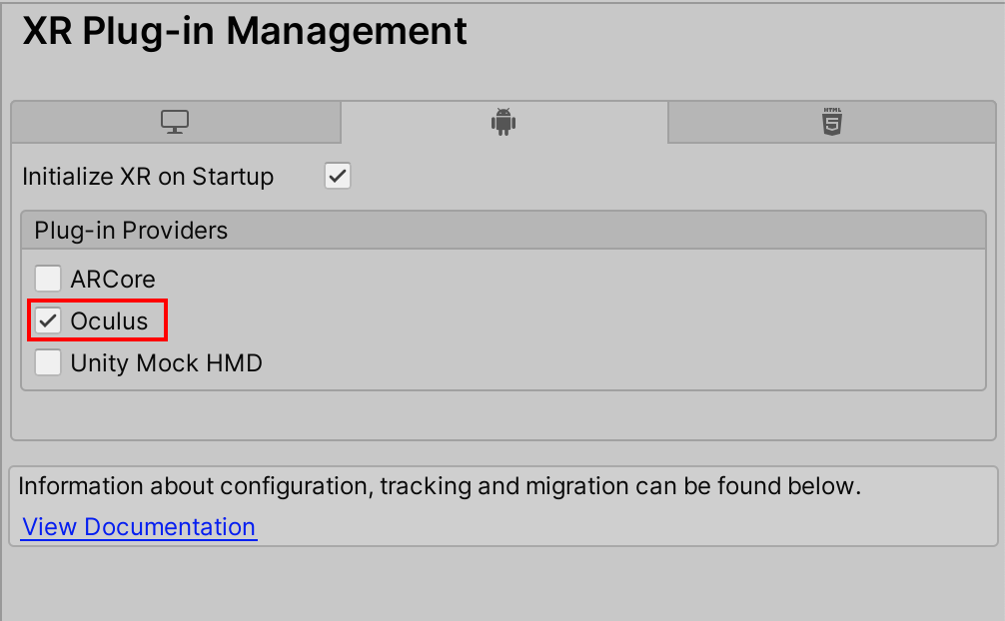
Configure Unity Project

Slide 11
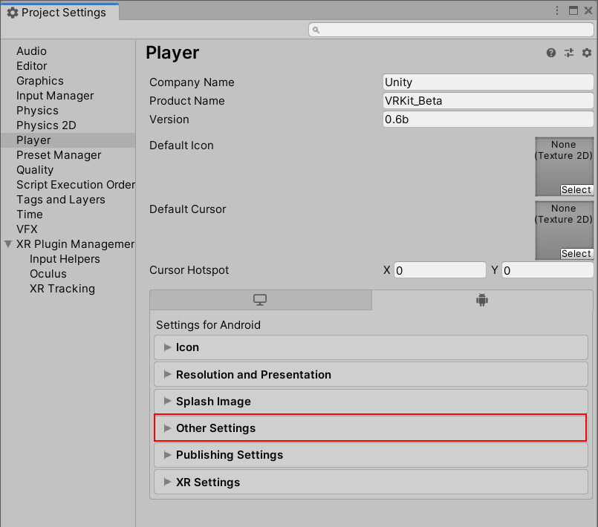
Configure Unity Project

Slide 12
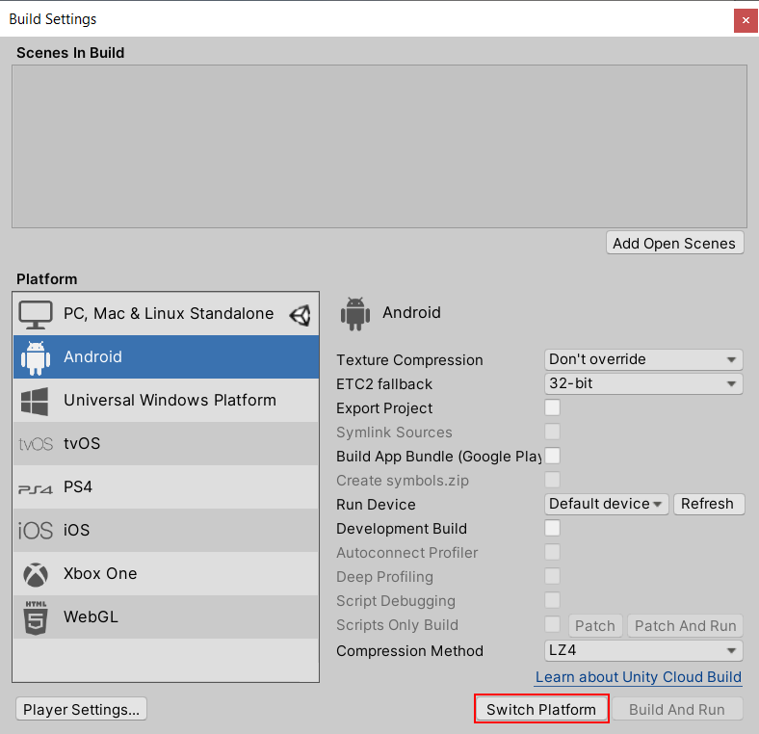
Configure Unity Project

